Slide 1
Sorting Algorithms

Slide 2
Sorting Algorithms
There are many sorting algorithms, such as:
  Bubble Sort
  Selection Sort
  Insertion Sort
  Merge Sort
  Quick Sort
The first three are the foundations for faster and more efficient algorithms.

Slide 3
Mergesort
The merge sort algorithm is one of two important divide-and-conquer sorting algorithms (the other one is quicksort).
It is a recursive algorithm.
  Divide the list into halves,
  Sort each half separately, and
  Then merge the sorted halves into one sorted array.

Slide 4
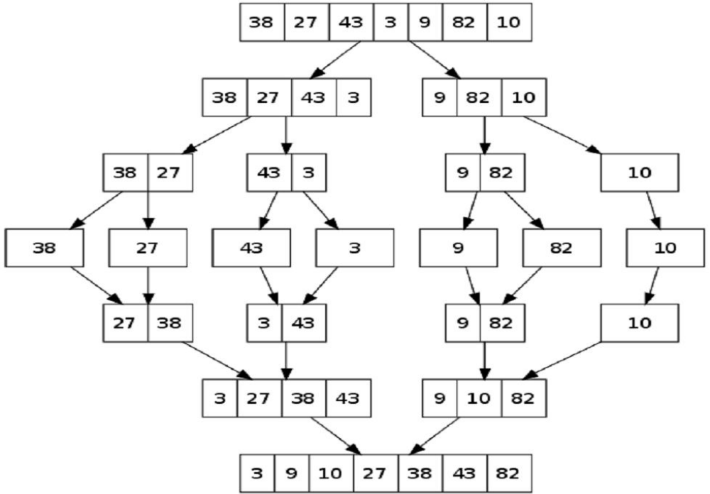
Mergesort - Example

Slide 5
Mergesort - Example
6 | 3 | 9 | 1 | 5 | 4 | 7 | 2
divide
6 | 3 | 9 | 1
5 | 4 | 7 | 2
divide
divide
6 | 3
9 | 1
5 | 4
7 | 2
divide
divide
divide
divide
6
3
9
1
5
4
7
2
merge
merge
merge
merge
3 | 6
1 | 9
4 | 5
2 | 7
merge
merge
1 | 3 | 6 | 9
2 | 4 | 5 | 7
merge
1 | 2 | 3 | 4 | 5 | 7 | 8 | 9

Slide 6
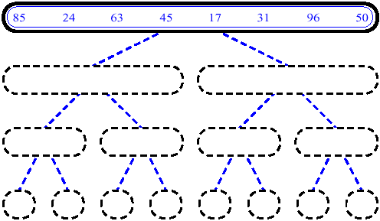
MergeSort (Example) - 1

Slide 7
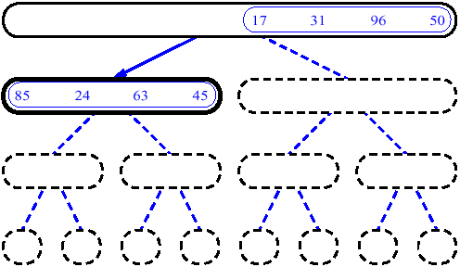
MergeSort (Example) - 2

Slide 8
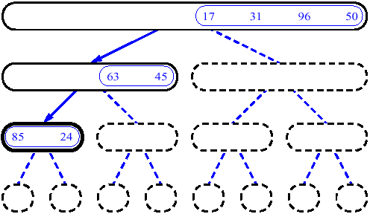
MergeSort (Example) - 3

Slide 9
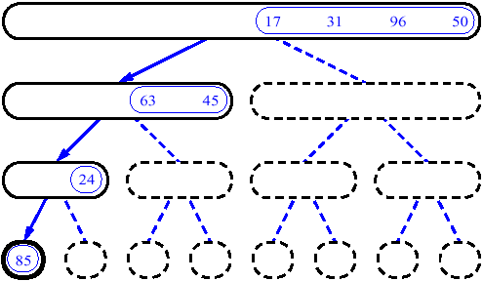
MergeSort (Example) - 4

Slide 10
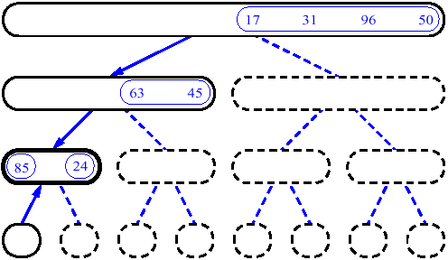
MergeSort (Example) - 5

Slide 11
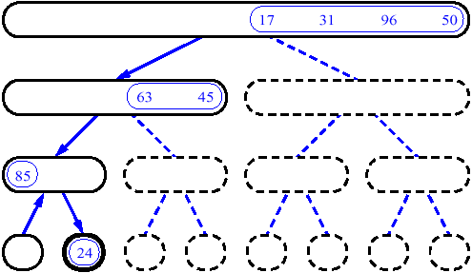
MergeSort (Example) - 6

Slide 12
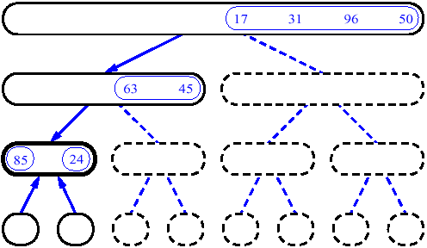
MergeSort (Example) - 7

Slide 13
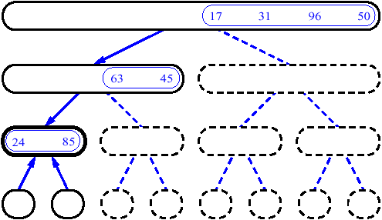
MergeSort (Example) - 8

Slide 14
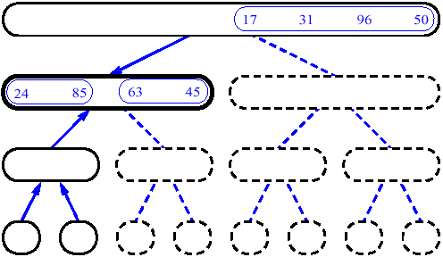
MergeSort (Example) - 9

Slide 15
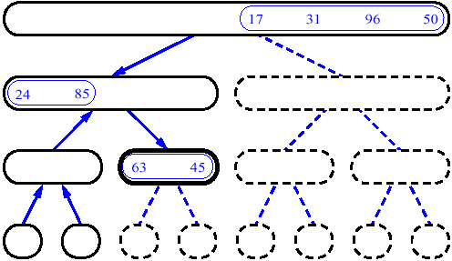
MergeSort (Example) - 10

Slide 16
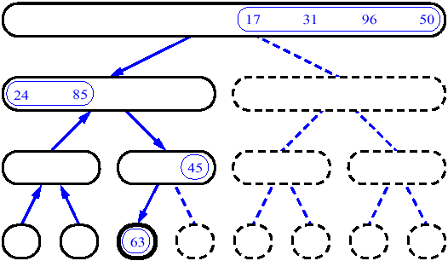
MergeSort (Example) - 11

Slide 17
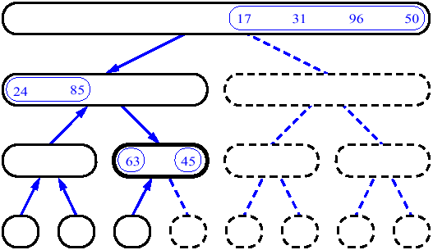
MergeSort (Example) - 12

Slide 18
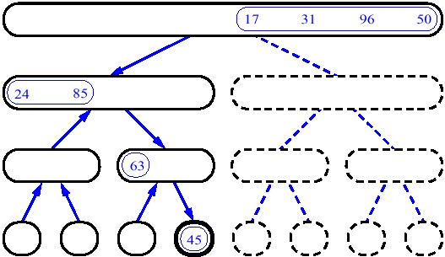
MergeSort (Example) - 13

Slide 19
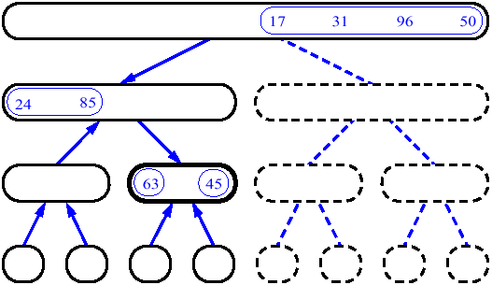
MergeSort (Example) - 14

Slide 20
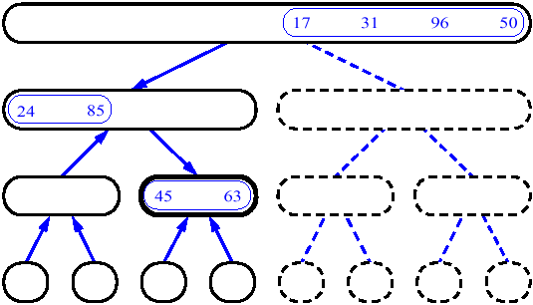
MergeSort (Example) - 15

Slide 21
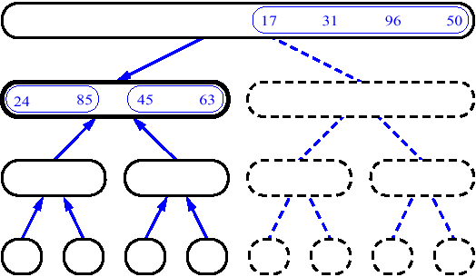
MergeSort (Example) - 16

Slide 22
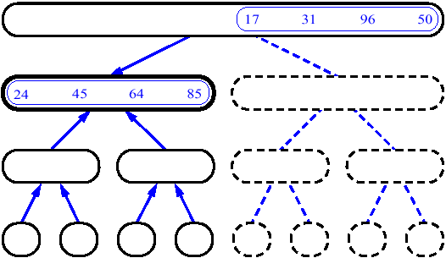
MergeSort (Example) - 17

Slide 23
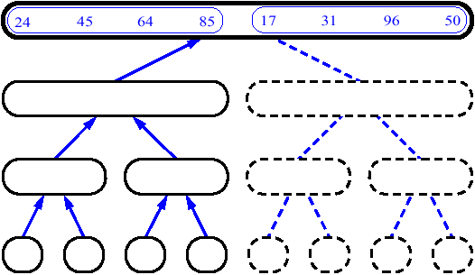
MergeSort (Example) - 18

Slide 24
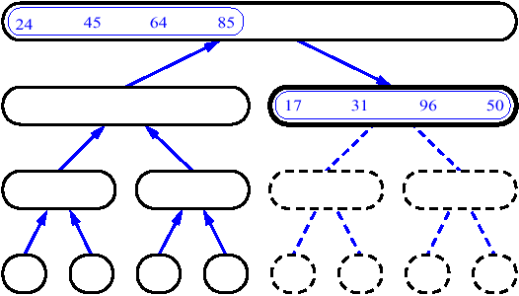
MergeSort (Example) - 19

Slide 25
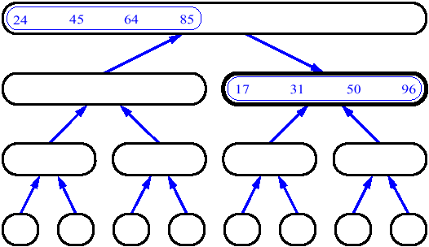
MergeSort (Example) - 20

Slide 26
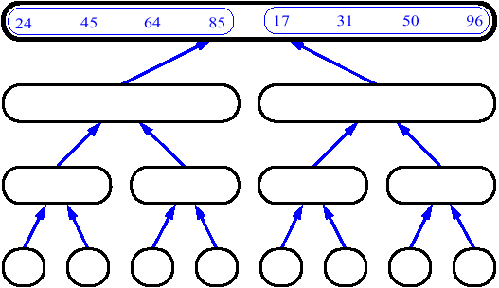
MergeSort (Example) - 21

Slide 27
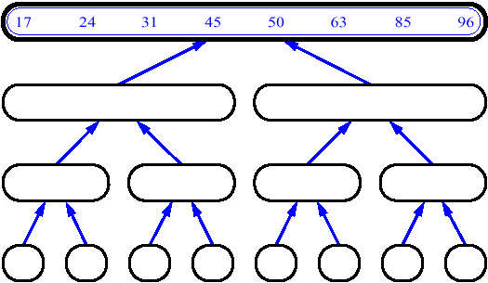
MergeSort (Example) - 22

Slide 28
14
23
45
98
6
33
42
67

Slide 29
14
23
45
98
6
33
42
67
Merge

Slide 30
14
23
45
98
6
33
42
67
6
Merge

Slide 31
14
23
45
98
6
33
42
67
6
14
Merge

Slide 32
14
23
45
98
6
33
42
67
6
14
23
Merge

Slide 33
14
23
45
98
6
33
42
67
6
14
23
33
Merge

Slide 34
14
23
45
98
6
33
42
67
6
14
23
33
42
Merge

Slide 35
14
23
45
98
6
33
42
67
6
14
23
33
42
45
Merge

Slide 36
14
23
45
98
6
33
42
67
6
14
23
33
42
45
67
Merge

Slide 37
14
23
45
98
6
33
42
67
6
14
23
33
42
45
67
98
Merge

Slide 38
Merge
const int MAX_SIZE = maximum-number-of-items-in-array;
void merge(DataType theArray[], int first, int mid, int last) {
DataType tempArray[MAX_SIZE]; // temporary array
int first1 = first; // beginning of first subarray
int last1 = mid; // end of first subarray
int first2 = mid + 1; // beginning of second subarray
int last2 = last; // end of second subarray
int index = first1; // next available location in tempArray
for ( ; (first1 <= last1) && (first2 <= last2); ++index) {
if (theArray[first1] < theArray[first2]) {
tempArray[index] = theArray[first1];
++first1;
}
else {
tempArray[index] = theArray[first2];
++first2;
} }

Slide 39
Merge (cont.)
// finish off the first subarray, if necessary
for (; first1 <= last1; ++first1, ++index)
tempArray[index] = theArray[first1];
// finish off the second subarray, if necessary
for (; first2 <= last2; ++first2, ++index)
tempArray[index] = theArray[first2];
// copy the result back into the original array
for (index = first; index <= last; ++index)
theArray[index] = tempArray[index];
} // end merge

Slide 40
Mergesort
void mergesort(DataType theArray[], int first, int last) {
if (first < last) {
int mid = (first + last)/2; // index of midpoint
mergesort(theArray, first, mid);
mergesort(theArray, mid+1, last);
// merge the two halves
merge(theArray, first, mid, last);
}
} // end mergesort

Slide 41
Quicksort
Like mergesort, Quicksort is also based on the divide-and-conquer paradigm.
Quicksort is a divide and conquer algorithm, which relies on a partition operation: to partition an array, we choose an element, called a pivot, move all smaller elements before the pivot, and move all greater elements after it.
This can be done efficiently in linear time and in-place. We then recursively sort the lesser and greater sublists. Efficient implementations of quicksort (with in-place partitioning) are somewhat complex, but are among the fastest sorting algorithms in practice. The most complex issue in quicksort is choosing a good pivot element; consistently poor choices of pivots can result in drastically slower.

Slide 42
Quicksort (cont.)
The quick-sort algorithm consists of the following three steps:
1. Divide: Partition the list.
  To partition the list, we first choose some element from the list for which we hope about half the elements will come before and half after. Call this element the pivot.
  Then we partition the elements so that all those with values less than the pivot come in one sublist and all those with greater values come in another.
2. Recursion: Recursively sort the sublists separately.
3. Conquer: Put the sorted sublists together.

Slide 43
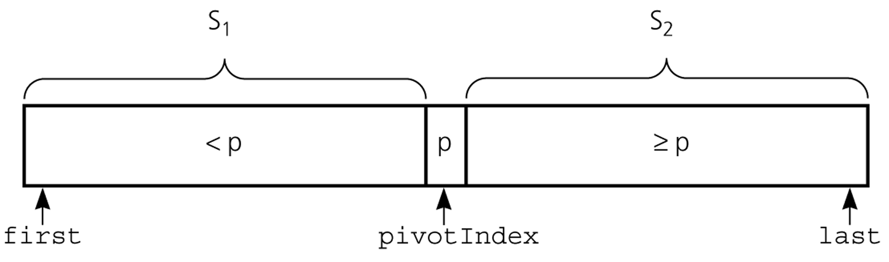
Partition
Partitioning places the pivot in its correct place position within the array.
Arranging the array elements around the pivot p generates two smaller sorting problems.
  sort the left section of the array, and sort the right section of the array.
  when these two smaller sorting problems are solved recursively, our bigger sorting problem is solved.

Slide 44
Partition – Choosing the pivot
First, we have to select a pivot element among the elements of the given array, and we put this pivot into the first location of the array before partitioning.
Which array item should be selected as pivot?
  Somehow we have to select a pivot, and we hope that we will get a good partitioning.
  If the items in the array arranged randomly, we choose a pivot randomly.
  We can choose the first or last element as a pivot (it may not give a good partitioning).
  We can use different techniques to select the pivot.

Slide 45
Partition Function
template <class DataType>
void partition(DataType theArray[], int first, int last,
int &pivotIndex) {
// Partitions an array for quicksort.
// Precondition: first <= last.
// Postcondition: Partitions theArray[first..last] such that:
// S1 = theArray[first..pivotIndex-1] < pivot
// theArray[pivotIndex] == pivot
// S2 = theArray[pivotIndex+1..last] >= pivot
// Calls: choosePivot and swap.
// place pivot in theArray[first]
choosePivot(theArray, first, last);
DataType pivot = theArray[first]; // copy pivot

Slide 46
Partition Function (cont.)
// initially, everything but pivot is in unknown
int lastS1 = first; // index of last item in S1
int firstUnknown = first + 1; //index of 1st item in unknown
// move one item at a time until unknown region is empty
for (; firstUnknown <= last; ++firstUnknown) {
// Invariant: theArray[first+1..lastS1] < pivot
// theArray[lastS1+1..firstUnknown-1] >= pivot
// move item from unknown to proper region
if (theArray[firstUnknown] < pivot) { // belongs to S1
++lastS1;
swap(theArray[firstUnknown], theArray[lastS1]);
} // else belongs to S2
}
// place pivot in proper position and mark its location
swap(theArray[first], theArray[lastS1]);
pivotIndex = lastS1;
} // end partition

Slide 47
Quicksort Function
void quicksort(DataType theArray[], int first, int last) {
// Sorts the items in an array into ascending order.
// Precondition: theArray[first..last] is an array.
// Postcondition: theArray[first..last] is sorted.
// Calls: partition.
int pivotIndex;
if (first < last) {
// create the partition: S1, pivot, S2
partition(theArray, first, last, pivotIndex);
// sort regions S1 and S2
quicksort(theArray, first, pivotIndex-1);
quicksort(theArray, pivotIndex+1, last);
}
}

Slide 48
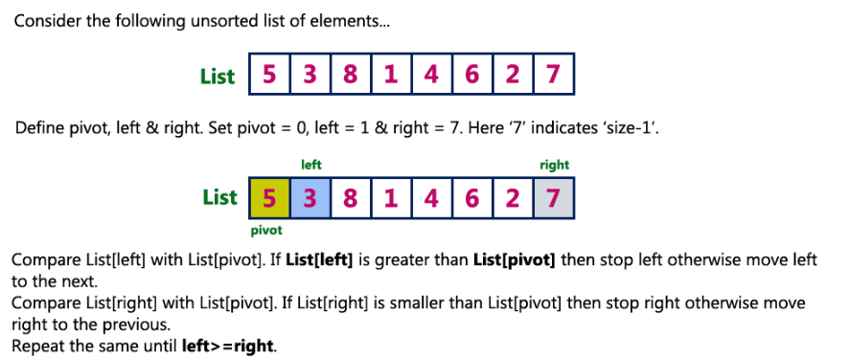
Quicksort

Slide 49
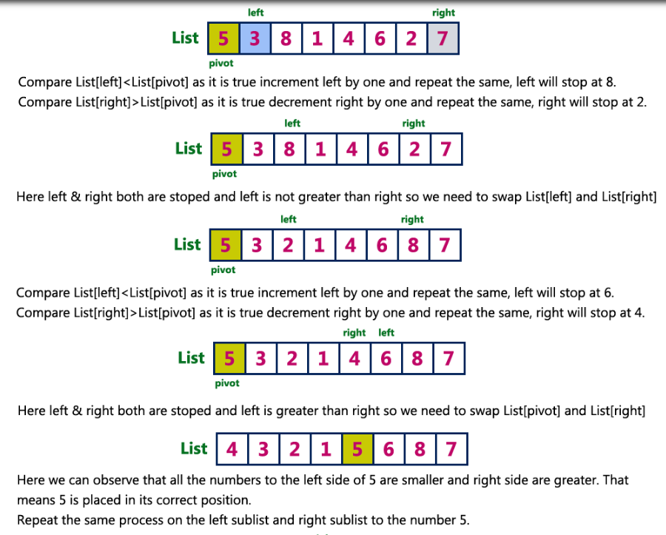

Slide 50
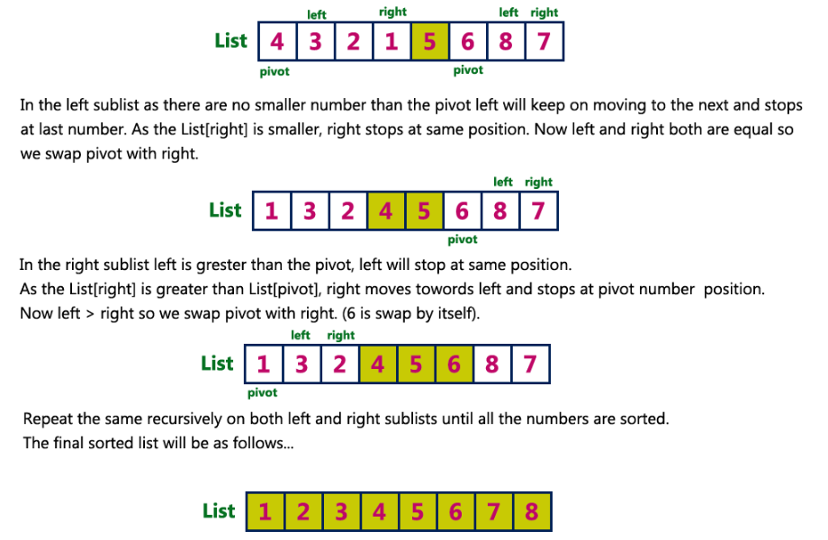
Quicksort

Slide 51
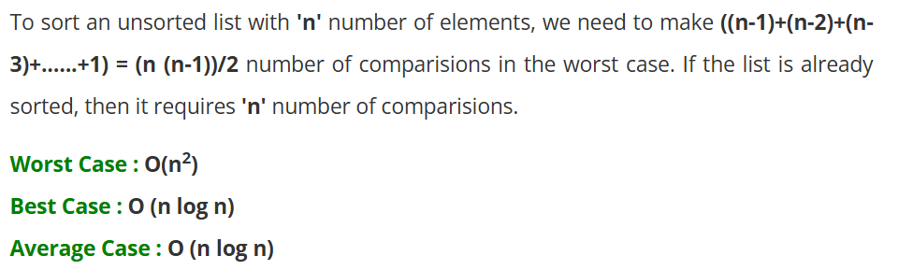
Complexity of the Quicksort

Slide 52
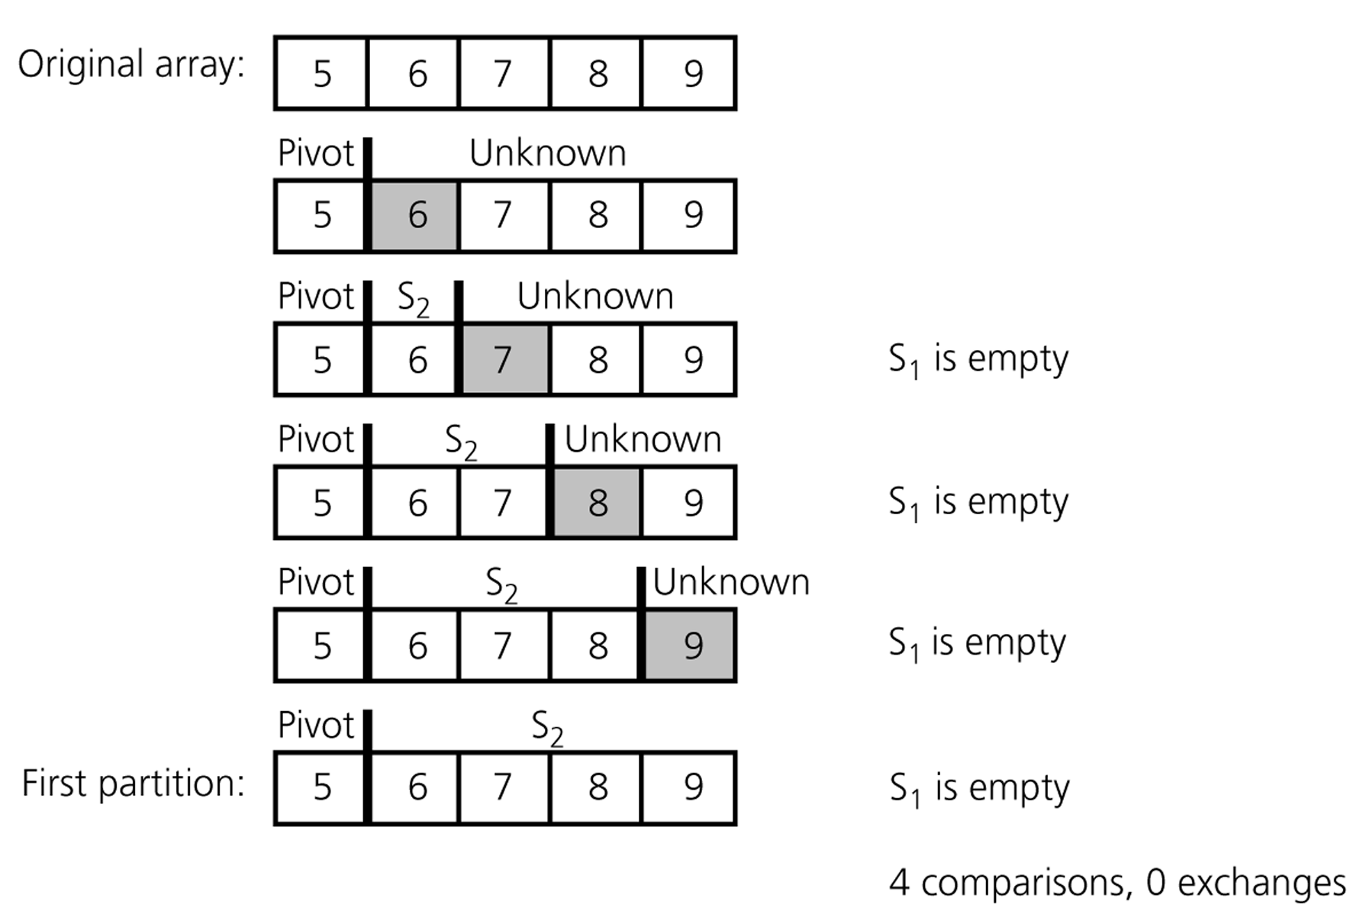
Quicksort – Analysis
A worst-case partitioning with quicksort

